Slide 1
Hospital management system
Team no: 6
Team members:
B jahnavi sri kavya
S vishnupriya
B priyanka

Slide 2
objectives
The project “Hospital management system” is aimed to develop to maintain the day –to-day state of admission/discharge of patients, list of doctors, reports generation etc. It is designed to achieve the following objectives:
To computerize all details regarding patient details & hospital details.
Scheduling the appointment of patient with doctors to make it convenient for both.
The inventory should be updated automatically whenever a transaction is made.
The information of the patients should be kept up to date and there record should be kept in the system for historical purposes.

Slide 3
Software requirements & Work done
Software Requirements:
Java jdk1.8.0_221
DATABASE : Mysql
Work Done:

Slide 4
Algorithm
FOR DOCTORS:
Step 1:
Start.
Step 2:
Open Hospital Management web page, to create new membership for Doctor proceed with step 3 or if there is existing user proceed with step 6.
Step 3:
Click on new membership link to create new membership for doctor. Allocate memory for storing the information of new doctor.
Step 4:
Enter the information of the new doctor.

Slide 5
Step 5:
Proceed if all information are entered properly and display new account details, else show appropriate error for incorrect information.
Step 6:
You can search the patients who are treated under respective doctor by clicking on the link.
Step 7:
You can check the patient health report, account details of patient and also doctor (Salary), date of treatment.
FOR PATIENTS:
Step 1:
Open Hospital Management web page, to create new membership for patient proceed with step 2 or if there is existing user proceed with step 5.
Step 2:
Click on new membership link to create new membership for patient. Allocate memory for storing the information of new patient.

Slide 6
Step 3:
Enter the information of the new patient.
Step 4:
Proceed if all information are entered properly and display new account details, else show appropriate error for incorrect information.
Step 5:
You can find your respective doctors by clicking respective link.
Step 6:
You can also find your health progress, treatment timings, medicine details, room allotment details, fee payment and discharge details.
Step 7:
Stop.

Slide 7
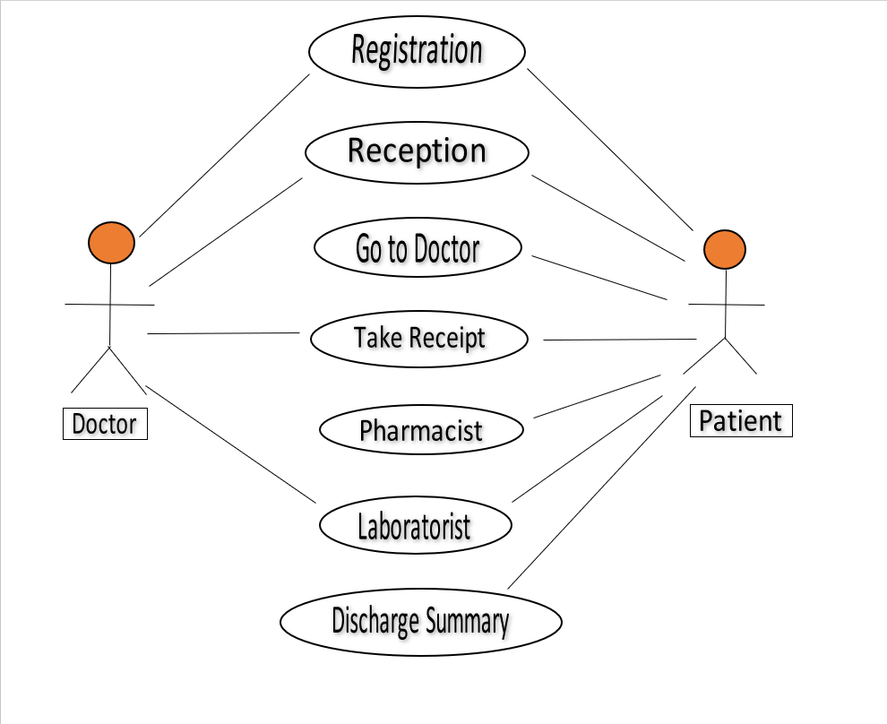
Use Case Diagram

Slide 8
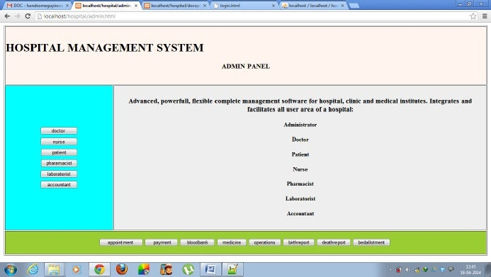
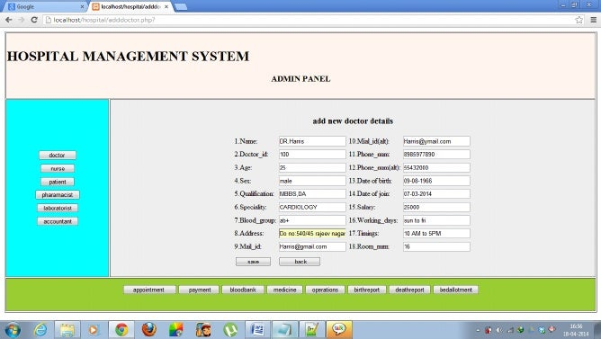
Miniature model

Slide 9
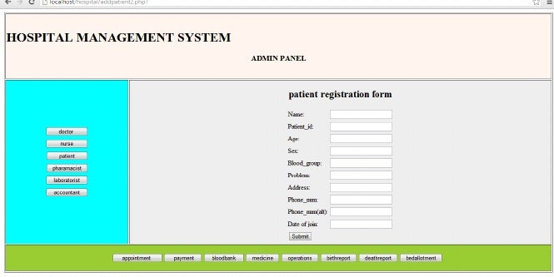
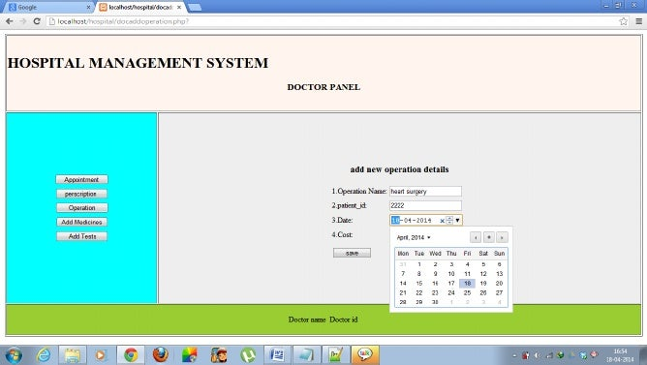
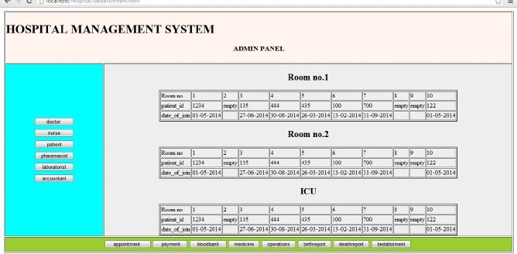

Slide 10
WORKS TO BE DONE

Slide 11
Specific references
Herbert Schildt, “The Java 2: Complete Reference”, Fifth edition, TMH.
MySQL Database Applications, 2nd Edition by Brad Bulger

